Slide 1
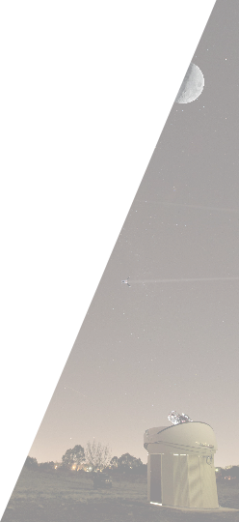

ZEIT 4507: Space Situational Awareness
Lecture 13: Batch Estimation
School of Engineering and Information Technology
Steve Gehly (s.gehly@adfa.edu.au)
Melrose Brown (melrose.brown@adfa.edu.au)
Andrew Lambert (a-lambert@adfa.edu.au

Slide 2

Learning Objectives
Topics of Study
Overview of orbital mechanics and perturbations
Debris sources, distribution, and evolution in time
Contemporary debris analysis software tools
Analysis of collision probabilities and mitigation strategies
Effects of space environment on debris
Role of policy in sustainability of future space operations
Learning Outcomes
Define the primary sources and distribution of debris in Earth orbit
Compute and analyse evolution of the orbital debris population
Analyze ground-based sensor data for space object characterization
Understand the influence of the space environment on orbital debris
Appreciate the role of policy in ensuring the sustainability of future space operations
Understand the principle technical approaches involved in maintaining space situational awareness and ensuring sustainability of future space operations
Notes:
Challenges: Nose, signal cut due to boundray, Bias …

Slide 3
Course Schedule
Week | Monday (10:00-11:30) | Wednesday (11:00-12:30) | Tuesday Lab (16:00-18:00)
1 (13-Jul) | Overview of Debris Environment | Overview of the Debris Environment | MASTER Tutorial Session
2 (20-Jul) | Evolution Models | NewSpace, MegaConstellations | MASTER Working Session
3 (27-Jul) | Anomalies and Breakup Events | Mitigation and Remediation | MASTER Working Session
4 (03-Aug) | Space Environment (Melrose) | Space Policy and Law (Duncan Blake) | MASTER Working Session
5 (10-Aug) | Sensors (Andrew) | Sensors (Andrew) | MASTER Working Session
6 (17-Aug) | SACT | Military Training Day | SACT
7 (24-Aug) | Batch Estimation | Sequential Estimation | MASTER Lab Due
Mid-Semester Break
8 (14-Sept) | Nonlinear Estimation | Object Characterization (Quiz) | Falcon Working Session
9 (21-Sept) | Maneuver Detection | Conjunction Assessment (Quiz) | Falcon Working Session
10 (28-Sept) | Uncertainty Quantification | Initial Orbit Determination (Quiz) | Falcon Working Session
11 (05-Oct) | Labour Day | Data Association (Quiz) | Falcon Working Session
12 (12-Oct) | Multitarget Estimation | Sensor Management (Quiz) | Falcon Lab Report Due
13 (19-Oct) | Data Fusion | Final Presentations | Off
Unit 1: Debris Overview & Environment
Unit 2: Space Surveillance and Tracking
Unit 3: Advanced Space Surveillance and Tracking
Notes:
Challenges: Nose, signal cut due to boundray, Bias …

Slide 4
SACT 20-2 Wrap Up
What does SSA look like right now?
In the US, the 18th Space Command Squadron (18SCS) which is part of the Combined Space Operations Center (CSpOC) manages the TLE catalog and conjunction warning service for space operators around the world (military, civil, commercial)
Broadly speaking, their job looks like what was seen in SACT:
Task sensors to regularly observe catalog objects, with focus on a high rate revisit list, and search regions of space for new objects
Monitor open source information for reports of events such as launches, anomalies, breakups, …
Respond to events observed in these data sources by retasking sensors to get additional data
What is the purpose of SACT?
US DoD is currently providing this service globally, free of charge, which is not sustainable
US DoD has vested interested in preventing collisions in general but their immediate interest is to “protect and defend” their assets and their allies
With advent of NewSpace/MegaConstellations the existing system is no longer adequate
There is a need for a civil-commercial SSA capability
Good news: there are many existing companies with sensors, SSA data processing capability
Challenges: getting them to work together as global team, with input and interaction from military, which will still have a role in SSA
SACT exists to begin developing and testing this integrated capability

Slide 5
SACT 20-2 Wrap Up
What is different between SACT and Regular SSA Operations?
CSpOC is centralized, owns every aspect of SSA from sensors to data processing and analysis capability which reduces logistics, coordination overhead, much more automation
Some events such as launch/breakup are simulated to ensure the team gets tested
Pace of events
Real SSA runs 24/7 but generally less going on at any given time
Barbara Golf “varsity batshit crazy space operations” designed to test military wartime SSA capability working in coordination with civil-commercial SSA to cover non-military assets
Overall process, data and analysis needs are the same
Notable Events and Outcomes
Vul2 there was an event tracking a simulated launch from China that stretched across all 3 teams
Direct launch to GTO
At apogee, satellite deployed
Intended as MEV like mission for satellite servicing
As part of the simulated satellite’s early operations, it attempted to separate and then rendezvous with the rocket body that delivered it to orbit
The third maneuver in the sequence was modeled as having gone wrong, leading to a collision with the rocket body generating several debris objects
Teams successfully “tracked” this simulated case and analysis of what happened was close to truth

Slide 6
SACT 20-2 Wrap Up
Notable Events and Outcomes
Several real events in GEO (maneuvers?) dismissed as pattern of life
Military started going to commercial with questions (they had high rate of events to contend with and offloaded) – good!
Looks like several LEO events were missed (simulated MLI shedding, real-world Iridium attitude maneuvers)
Pacific cell lacked taskable sensors – operating during day, need partner optical sensors on night side to respond to tasking requests
NASA GPIM deorbit, not sure that we caught, too low inclination for LeoLabs radar
PSRA group performed very well, special thanks to Avery and Kieran
What’s Next?
SACT 20-3 in November if anyone is interested in participating
SACT events to continue over next few years as Dept of Commerce in US takes over main space traffic management function
Remainder of our semester will focus on individual SSA analysis tasks that were performed by teams within SACT, including:
Orbit determination, Initial Orbit Determination
Object Characterization
Maneuver Detection
Conjunction Assessment
Data Association/Multitarget Estimation
Sensor Management and Data Fusion

Slide 7
Administrative Notes
Assessments
Homework 2 Solutions
Homework 4 Due Wednesday (final homework)
Lab Project 1 Due Friday
Final Project Proposal (part of HW4) Due Wed
Schedule
Lecture this week to cover estimation – bridge the gaps from sensors collecting measurements to SACT-style SSA data products (catalog updates, conjunctions, characterization, …)
Lab Session Office Hours
Estimation Theory
The rest of the semester is geared around how to process measurement data, with unknown errors, to produce information we need for space operators to make decisions, e.g.:
Is my spacecraft at risk of collision?
Does an adversary spacecraft pose some other kind of threat?
What is spacecraft X doing and is it normal behavior or out of the ordinary?
The most basic first step in all of these questions is applying radar/optical measurements of range, angles, and associated rates of change to determine the most likely position and velocity of space objects, a process referred to as orbit determination.

Slide 8
Problem Statement
Orbit Determination
The orbit determination problem is summarized as follows:
We don’t know exactly where we are or where anything else is in the universe
Our models for how objects move in space are incomplete and inaccurate
We must estimate our location and the location of objects in space using measurements
The measurements have errors which are not precisely known
Problem Approach
In spite of these challenges, we can still develop a solution to the problem
By collecting enough measurements, we can determine a “most likely” solution that fits our observations and physical models
We can further characterize the uncertainty in our solution and measurement system

Slide 9
Measurements

Slide 10

Measurements
Even in the best case scenario, we never know exactly where an object is in space, nor do we have a perfect model of the dynamical forces. For these reasons, it is essential to regularly collect measurements of objects in space, which are then processed to estimate the orbital state (pos/vel, elements). This process is known as orbit determination.
The measurements available depend on whether the space object is active or debris, if it has a GPS or radio comms, orbit regime, radar/optical cross section, etc. All measurements will have errors, we generally assume these are random (Gaussian distributed) and can be characterized by a mean and standard deviation (usually assume zero-mean error, non-zero mean error is called a bias in measurements).
Example Measurement Types:
Range ($ρ$) – distance between sensor and target
Range-rate ($\dot{ρ}$) – time derivative of range
Angles ($α,δ$) – usually given in pairs, specify line-of-sight (LOS) unit vector from sensor to target
Angle-rates ($\dot{α},\dot{δ}$) – time derivatives of angles
GPS ($x,y,z$) – Cartesian position coordinates, sometimes provide velocities as well

Slide 11
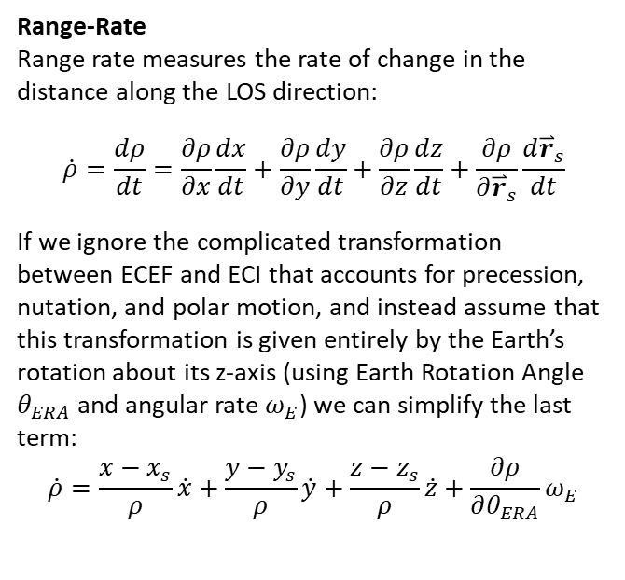
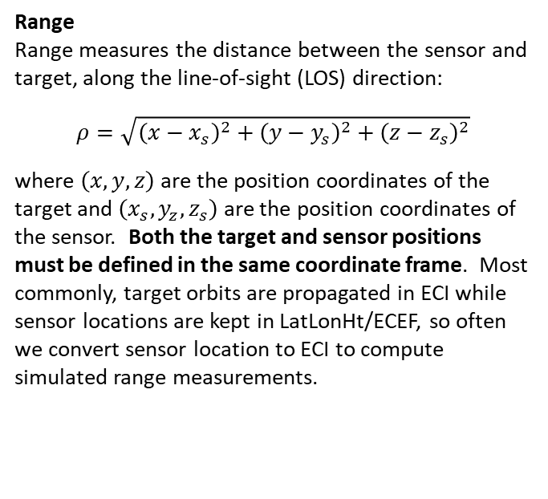
Range and Range-Rate Definition
Range
Range measures the distance between the sensor and target, along the line-of-sight (LOS) direction:
$$ρ=\sqrt{{\left(x−x_{s}\right)}^{2}+{\left(y−y_{s}\right)}^{2}+{\left(z−z_{s}\right)}^{2}}$$
where $\left(x,y,z\right)$ are the position coordinates of the target and $\left(x_{s},y_{z},z_{s}\right)$ are the position coordinates of the sensor. Both the target and sensor positions must be defined in the same coordinate frame. Most commonly, target orbits are propagated in ECI while sensor locations are kept in LatLonHt/ECEF, so often we convert sensor location to ECI to compute simulated range measurements.
Range-Rate
Range rate measures the rate of change in the distance along the LOS direction:
$$\dot{ρ}=\frac{dρ}{dt}=\frac{∂ρ}{∂x}\frac{dx}{dt}+\frac{∂ρ}{∂y}\frac{dy}{dt}+\frac{∂ρ}{∂z}\frac{dz}{dt}+\frac{∂ρ}{∂{\overset{⃑}{r}}_{s}}\frac{d{\overset{⃑}{r}}_{s}}{dt}$$
If we ignore the complicated transformation between ECEF and ECI that accounts for precession, nutation, and polar motion, and instead assume that this transformation is given entirely by the Earth’s rotation about its z-axis (using Earth Rotation Angle $θ_{ERA}$ and angular rate $ω_{E}$) we can simplify the last term:
$$\dot{ρ}=\frac{x−x_{s}}{ρ}\dot{x}+\frac{y−y_{s}}{ρ}\dot{y}+\frac{z−z_{s}}{ρ}\dot{z}+\frac{∂ρ}{∂θ_{ERA}}ω_{E}$$

Slide 12
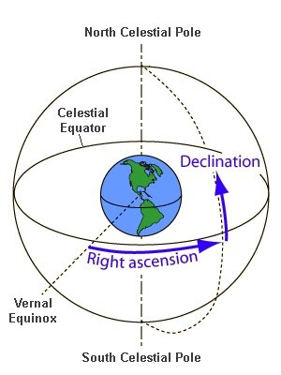
Right Ascension and Declination Definition
Spherical Coordinate System
Right ascension and declination are the angular coordinates of a celestial spherical coordinate system, similar to longitude and latitude for Earth-based locations. Along with a distance parameter, RA/DEC can be used to define a 3D position vector in space. By themselves, RA/DEC define the line-of-sight (LOS) unit vector pointing to the target. RA/DEC are often used to specify locations of celestial objects such as stars and planets, and can also be used for satellites.
Right Ascension – measured East from Vernal Equinox vector
Declination – measured North from celestial equator

Slide 13
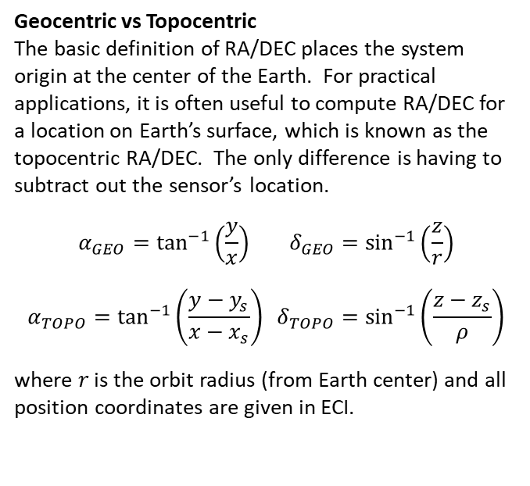
Right Ascension and Declination Definition
Geocentric vs Topocentric
The basic definition of RA/DEC places the system origin at the center of the Earth. For practical applications, it is often useful to compute RA/DEC for a location on Earth’s surface, which is known as the topocentric RA/DEC. The only difference is having to subtract out the sensor’s location.
$$α_{GEO}=\tan^{−1}\left(\frac{y}{x}\right) δ_{GEO}=\sin^{−1}\left(\frac{z}{r}\right)$$
$$α_{TOPO}=\tan^{−1}\left(\frac{y−y_{s}}{x−x_{s}}\right) δ_{TOPO}=\sin^{−1}\left(\frac{z−z_{s}}{ρ}\right)$$
where $r$ is the orbit radius (from Earth center) and all position coordinates are given in ECI.

Slide 14
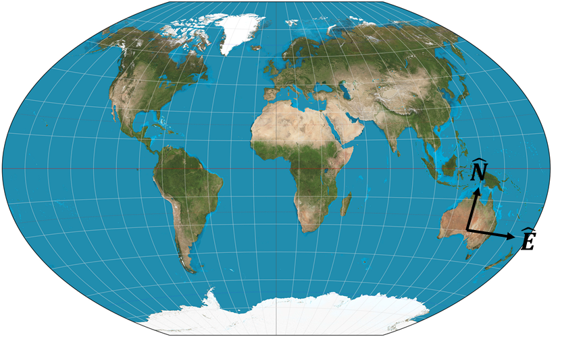
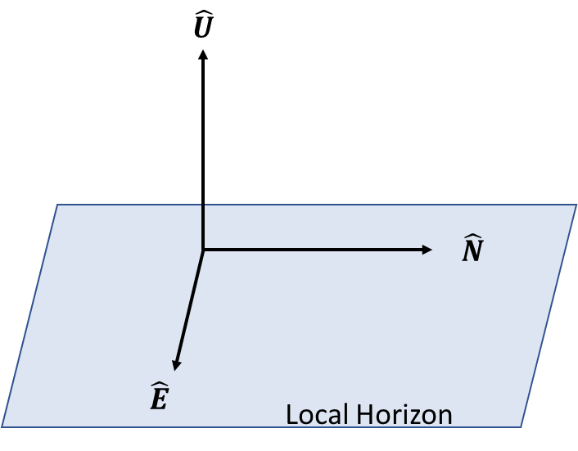
East-North-Up (ENU) Coordinate Frame
Coordinate System Definition
Define the East-North-Up (ENU) Coordinate System
Origin: Location in ECEF (or LatLonHt) coordinates, usually of a sensor on the Earth’s surface
X-axis: Aligned with local East direction
Y-axis: Aligned with local North direction
Z-axis: Complete right-hand system by pointing up, perpendicular to local horizon (plane defined by E-N)

Slide 15
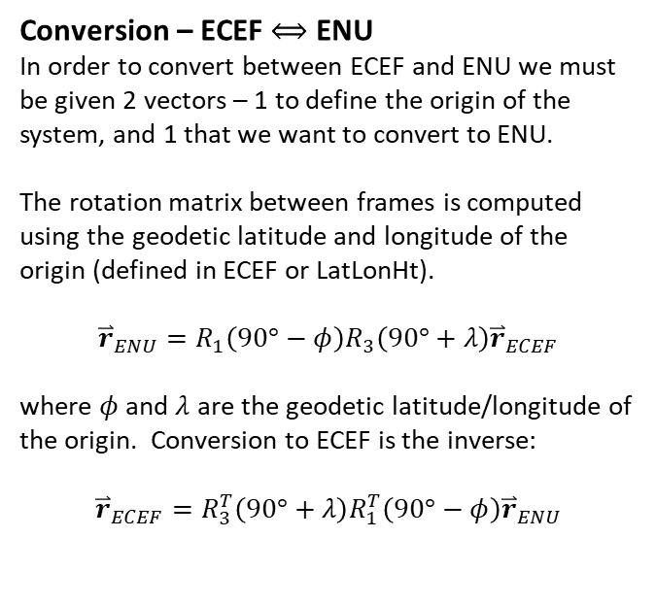
East-North-Up (ENU) Coordinate Frame
Conversion – ECEF $⟺$ ENU
In order to convert between ECEF and ENU we must be given 2 vectors – 1 to define the origin of the system, and 1 that we want to convert to ENU.
The rotation matrix between frames is computed using the geodetic latitude and longitude of the origin (defined in ECEF or LatLonHt).
$${\overset{⃑}{r}}_{ENU}=R_{1}\left(90°−φ\right)R_{3}\left(90°+λ\right){\overset{⃑}{r}}_{ECEF}$$
where $φ$ and $λ$ are the geodetic latitude/longitude of the origin. Conversion to ECEF is the inverse:
$${\overset{⃑}{r}}_{ECEF}=R_{3}^{T}\left(90°+λ\right)R_{1}^{T}\left(90°−φ\right){\overset{⃑}{r}}_{ENU}$$

Slide 16
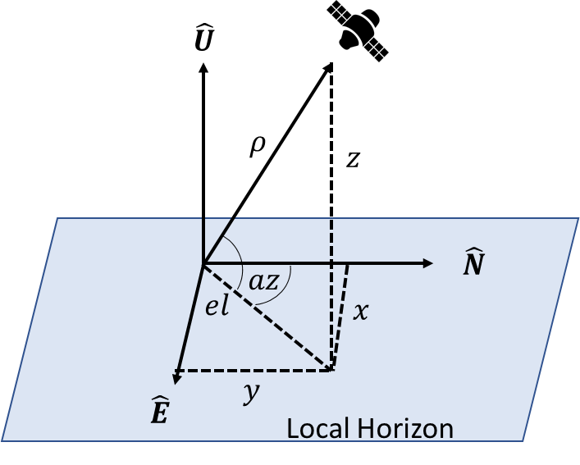
Azimuth and Elevation Definition
Topocentric Spherical Coordinates
Azimuth and Elevation also form a spherical coordinate system, in the ENU frame with origin at the Earth’s surface (topocentric). Az/El provide equivalent information to RA/DEC and can be used to define the LOS unit vector. The difference between topo RA/DEC and Az/El is the first is computed with coordinates in the ECI frame and the second is computed in the ENU frame. This means Az/El are measured relative to the local horizon and North directions, as opposed to inertial equator and Vernal Equinox.
Azimuth – Measured clockwise (East) from North
Elevation – Measured up from horizon

Slide 17
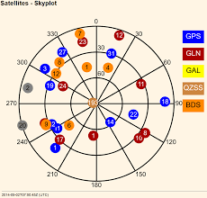
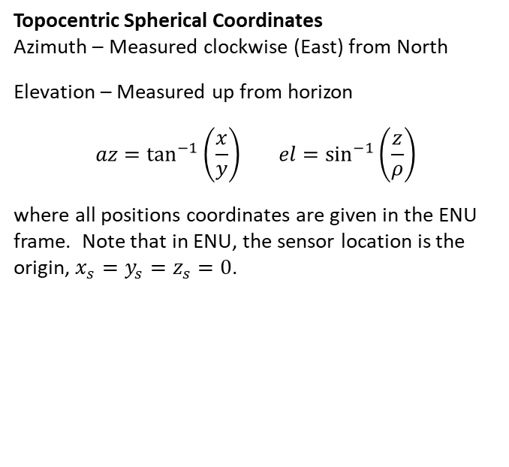
Azimuth and Elevation Definition
Topocentric Spherical Coordinates
Azimuth – Measured clockwise (East) from North
Elevation – Measured up from horizon
$$az=\tan^{−1}\left(\frac{x}{y}\right) el=\sin^{−1}\left(\frac{z}{ρ}\right)$$
where all positions coordinates are given in the ENU frame. Note that in ENU, the sensor location is the origin, $x_{s}=y_{s}=z_{s}=0$.

Slide 18
Classical Orbit Determination

Slide 19
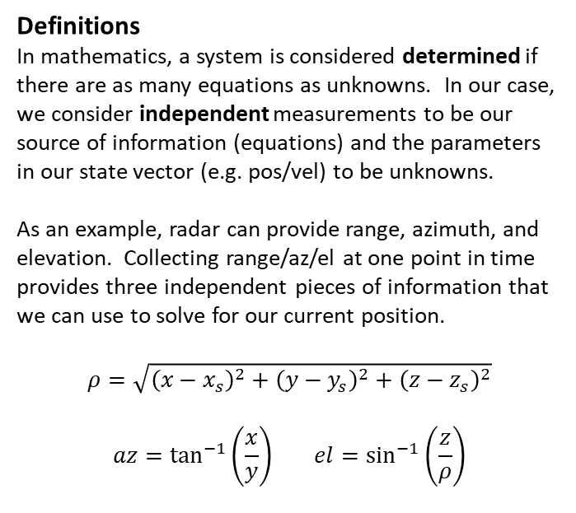
Determined vs Overdetermined
Definitions
In mathematics, a system is considered determined if there are as many equations as unknowns. In our case, we consider independent measurements to be our source of information (equations) and the parameters in our state vector (e.g. pos/vel) to be unknowns.
As an example, radar can provide range, azimuth, and elevation. Collecting range/az/el at one point in time provides three independent pieces of information that we can use to solve for our current position.
$$ρ=\sqrt{{\left(x−x_{s}\right)}^{2}+{\left(y−y_{s}\right)}^{2}+{\left(z−z_{s}\right)}^{2}}$$
$$az=\tan^{−1}\left(\frac{x}{y}\right) el=\sin^{−1}\left(\frac{z}{ρ}\right)$$
*Note in ENU coordinates, sensor location is the origin.

Slide 20
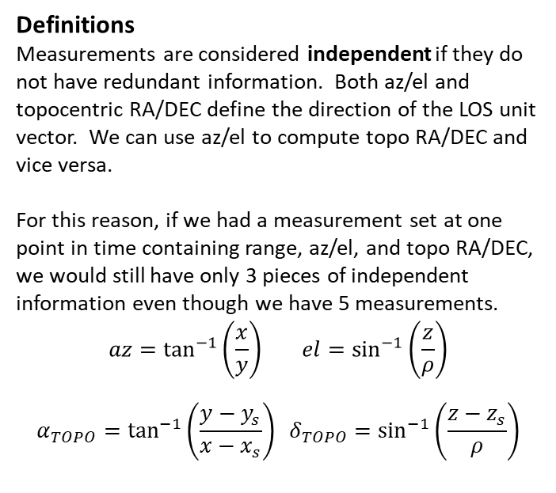
Determined vs Overdetermined
Definitions
Measurements are considered independent if they do not have redundant information. Both az/el and topocentric RA/DEC define the direction of the LOS unit vector. We can use az/el to compute topo RA/DEC and vice versa.
For this reason, if we had a measurement set at one point in time containing range, az/el, and topo RA/DEC, we would still have only 3 pieces of independent information even though we have 5 measurements.
$$az=\tan^{−1}\left(\frac{x}{y}\right) el=\sin^{−1}\left(\frac{z}{ρ}\right)$$
$$α_{TOPO}=\tan^{−1}\left(\frac{y−y_{s}}{x−x_{s}}\right) δ_{TOPO}=\sin^{−1}\left(\frac{z−z_{s}}{ρ}\right)$$
*Note in ENU coordinates, sensor location is the origin.

Slide 21
Determined vs Overdetermined
Definitions
In order for the orbit problem to be determined, we need 6 independent pieces of information to solve for the 6 unknowns in our state vector (pos/vel, elements). Generally, this means we need to collect measurements from multiple points in time.
In mathematics, when a system is determined we are able to solve using algebra, we have the same number of equations as unknowns. In the case we have additional information (more measurements) the system is considered overdetermined. In these cases, we solve an estimation problem, in which we apply statistics to not only solve the problem but also characterize the uncertainty in our solution using the extra information available to us.
Definitions
Another category of problem in mathematics is underdetermined, in which there are fewer equations (fewer measurements) than unknowns. In this circumstance, there are often many or perhaps infinitely many solutions that satisfy the physical model and fit the observations. In these cases, we solve an optimization problem, in which extra constraints are applied to determine a single solution. For example, with too few measurements it might be possible to find infinitely many trajectories that connect two points in measurement space. But by applying a constraint that the trajectory get from A to B in the least time, a single solution can be found.
We will focus on determined and overdetermined cases for our purposes.

Slide 22
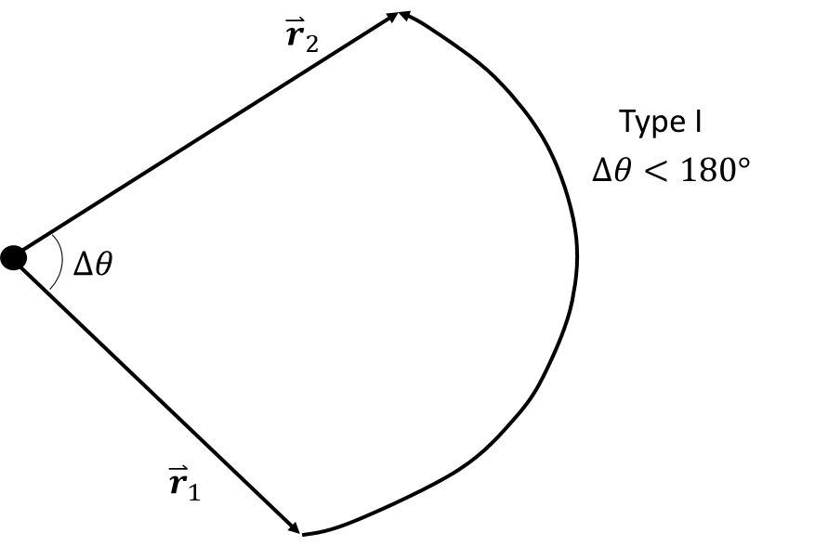
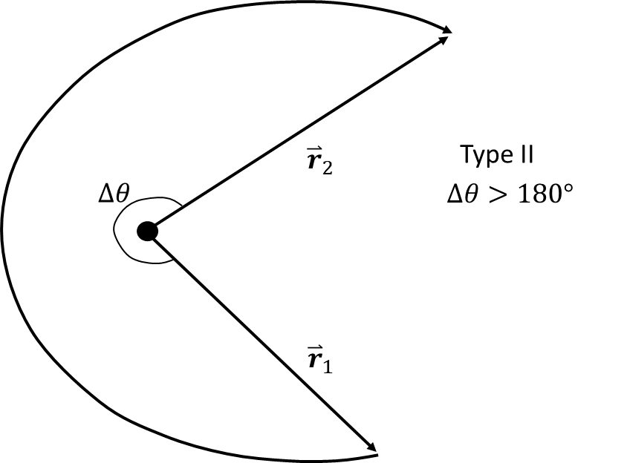
Determined Systems
Lambert’s Problem
In fact, we have already discussed one solution approach for determined systems in astrodynamics – Lambert’s Problem. Lambert’s problem is defined for the case that two 3D position vectors are given, as well as a time of flight between them.
This is equivalent to collecting a set of range/az/el measurements at two points in time. The range/az/el set can be turned into a 3D LOS range vector between the sensor and target. With these vectors at two different times, it is possible to solve the boundary value problem and compute the orbit.

Slide 23
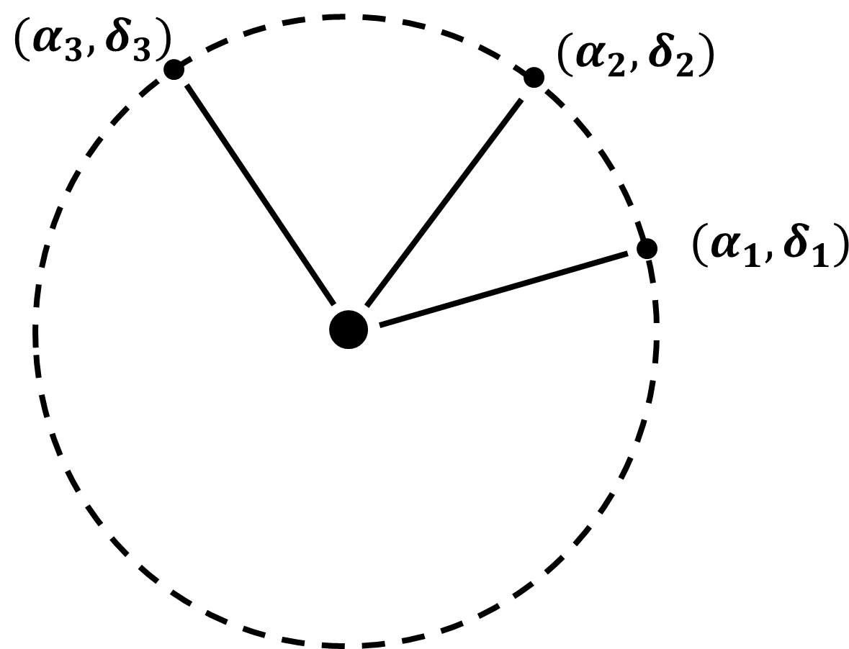
Determined Systems
Gauss Initial Orbit Determination (IOD)
Another commonly considered problem is the case where angles-only measurements are used. In this case, angles pairs from 3 different times are needed to solve for the 6 unknown orbit state parameters. Several solution approaches exist, among the most common is a method developed by Gauss.
Both Gauss IOD and Lambert’s problem rely on algebra to solve a determined system. For a given measurement set in each case, there should be at least one trajectory that fits our physical model (Two-Body conic section) and agrees with the measurements, the same way that in geometry any 2 points can define a line, or 3 points define a plane, etc.

Slide 24
Statistics Review

Slide 25
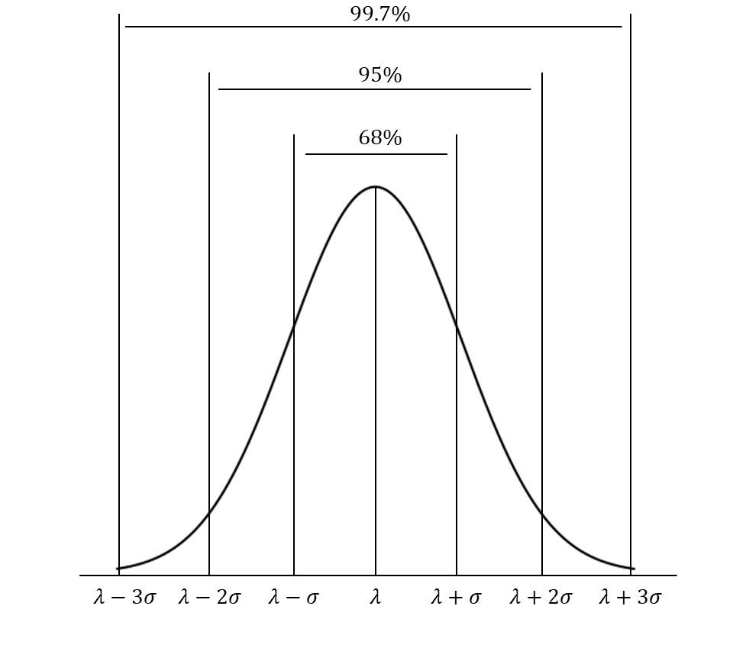
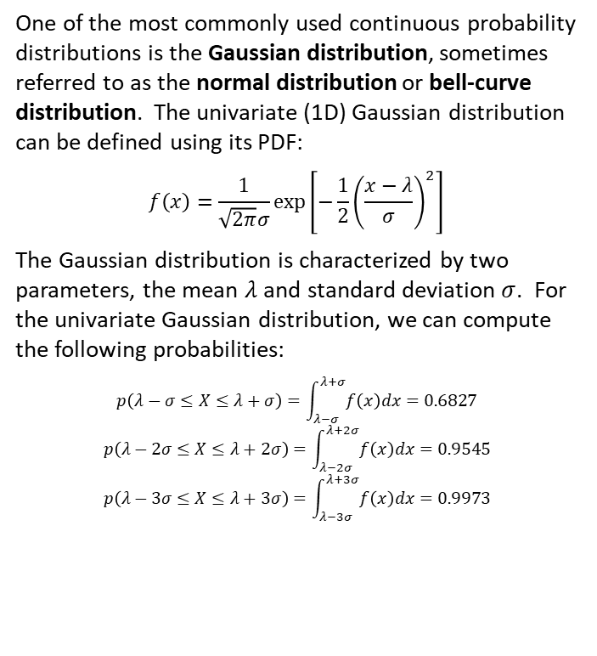
Gaussian Distribution
One of the most commonly used continuous probability distributions is the Gaussian distribution, sometimes referred to as the normal distribution or bell-curve distribution. The univariate (1D) Gaussian distribution can be defined using its PDF:
$$f\left(x\right)=\frac{1}{\sqrt{2π}σ}exp\left[−\frac{1}{2}{\left(\frac{x−λ}{σ}\right)}^{2}\right]$$
The Gaussian distribution is characterized by two parameters, the mean $λ$ and standard deviation $σ$. For the univariate Gaussian distribution, we can compute the following probabilities:
$$p\left(λ−σ≤X≤λ+σ\right)=\int_{λ−σ}^{λ+σ}{f\left(x\right)dx=0.6827}$$
$$p\left(λ−2σ≤X≤λ+2σ\right)=\int_{λ−2σ}^{λ+2σ}{f\left(x\right)dx=0.9545}$$
$$p\left(λ−3σ≤X≤λ+3σ\right)=\int_{λ−3σ}^{λ+3σ}{f\left(x\right)dx=0.9973}$$

Slide 26
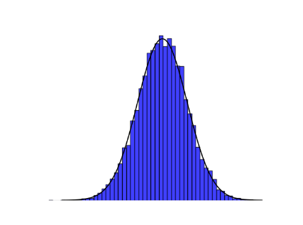
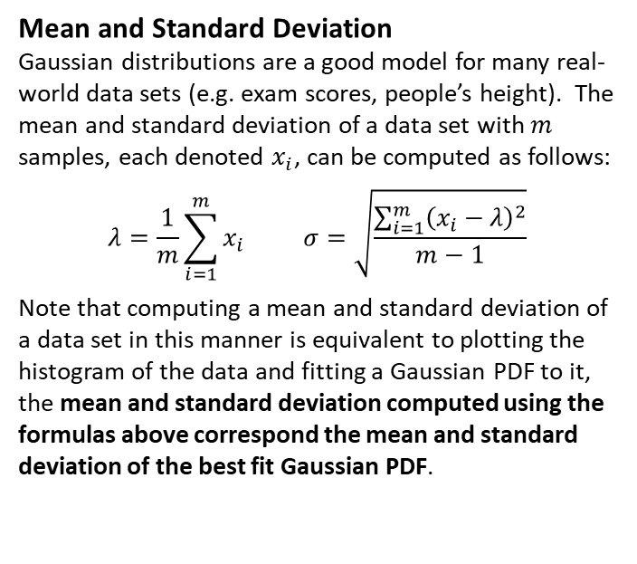
Gaussian Distribution
Mean and Standard Deviation
Gaussian distributions are a good model for many real-world data sets (e.g. exam scores, people’s height). The mean and standard deviation of a data set with $m$ samples, each denoted $x_{i}$, can be computed as follows:
$$λ=\frac{1}{m}\sum_{i=1}^{m}{x_{i}} σ=\sqrt{\frac{\sum_{i=1}^{m}{{\left(x_{i}−λ\right)}^{2}}}{m−1}}$$
Note that computing a mean and standard deviation of a data set in this manner is equivalent to plotting the histogram of the data and fitting a Gaussian PDF to it, the mean and standard deviation computed using the formulas above correspond the mean and standard deviation of the best fit Gaussian PDF.

Slide 27
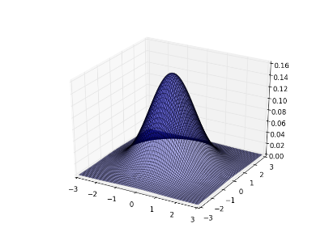
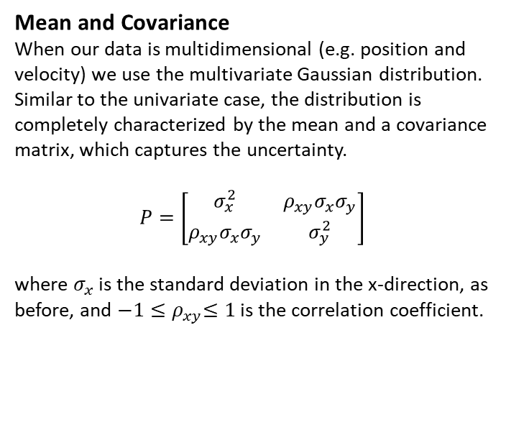
Multivariate Gaussian Distribution
Mean and Covariance
When our data is multidimensional (e.g. position and velocity) we use the multivariate Gaussian distribution. Similar to the univariate case, the distribution is completely characterized by the mean and a covariance matrix, which captures the uncertainty.
$$P=\left[\begin{matrix}σ_{x}^{2} & ρ_{xy}σ_{x}σ_{y} \\ ρ_{xy}σ_{x}σ_{y} & σ_{y}^{2}\end{matrix}\right]$$
where $σ_{x}$ is the standard deviation in the x-direction, as before, and ${−1≤ρ}_{xy}≤1$ is the correlation coefficient.

Slide 28
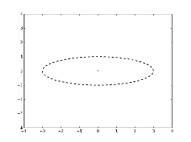
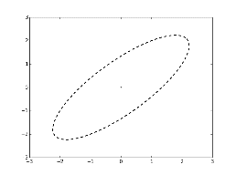
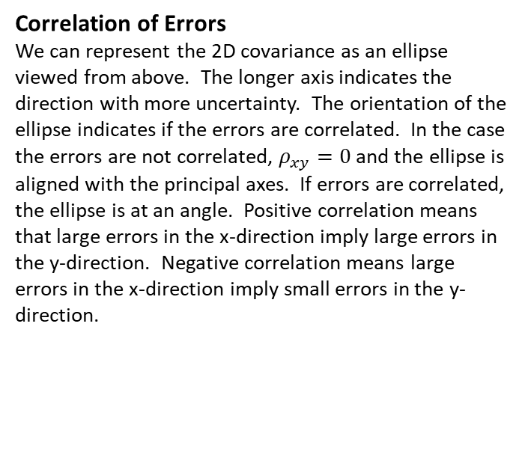
Multivariate Gaussian Distribution
Correlation of Errors
We can represent the 2D covariance as an ellipse viewed from above. The longer axis indicates the direction with more uncertainty. The orientation of the ellipse indicates if the errors are correlated. In the case the errors are not correlated, $ρ_{xy}=0$ and the ellipse is aligned with the principal axes. If errors are correlated, the ellipse is at an angle. Positive correlation means that large errors in the x-direction imply large errors in the y-direction. Negative correlation means large errors in the x-direction imply small errors in the y-direction.
Uncorrelated
Positively Correlated

Slide 29
Least Squares Estimation

Slide 30
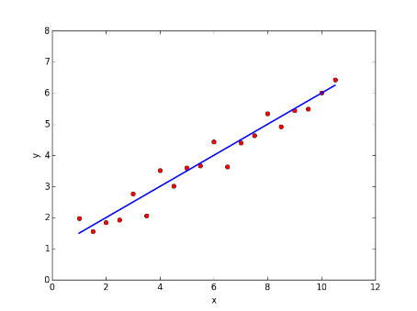
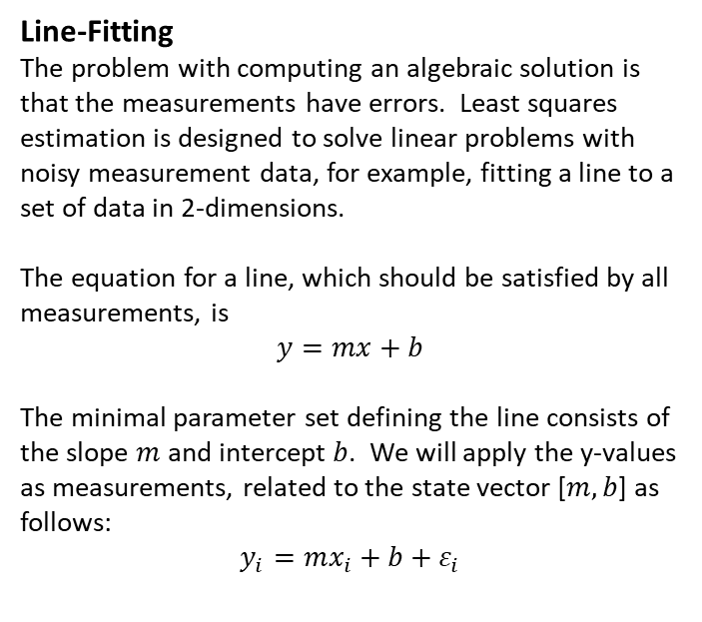
Least Squares Estimation
Line-Fitting
The problem with computing an algebraic solution is that the measurements have errors. Least squares estimation is designed to solve linear problems with noisy measurement data, for example, fitting a line to a set of data in 2-dimensions.
The equation for a line, which should be satisfied by all measurements, is
$$y=mx+b$$
The minimal parameter set defining the line consists of the slope $m$ and intercept $b$. We will apply the y-values as measurements, related to the state vector [$m,b$] as follows:
$$y_{i}=mx_{i}+b+ε_{i}$$

Slide 31
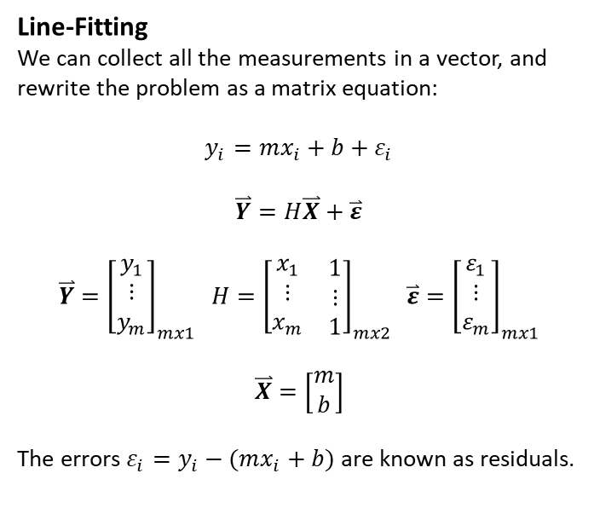
Least Squares Estimation
Line-Fitting
We can collect all the measurements in a vector, and rewrite the problem as a matrix equation:
$$y_{i}=mx_{i}+b+ε_{i}$$
$$\overset{⃑}{Y}=H\overset{⃑}{X}+\overset{⃑}{ε}$$
$$\overset{⃑}{Y}={\left[\begin{matrix}y_{1} \\ ⋮ \\ y_{m}\end{matrix}\right]}_{mx1} H={\left[\begin{matrix}\begin{matrix}x_{1} \\ ⋮ \\ x_{m}\end{matrix} & \begin{matrix}1 \\ ⋮ \\ 1\end{matrix}\end{matrix}\right]}_{mx2} \overset{⃑}{ε}={\left[\begin{matrix}ε_{1} \\ ⋮ \\ ε_{m}\end{matrix}\right]}_{mx1}$$
$$\overset{⃑}{X}=\left[\begin{matrix}m \\ b\end{matrix}\right]$$
The errors $ε_{i}=y_{i}−(mx_{i}+b)$ are known as residuals.

Slide 32
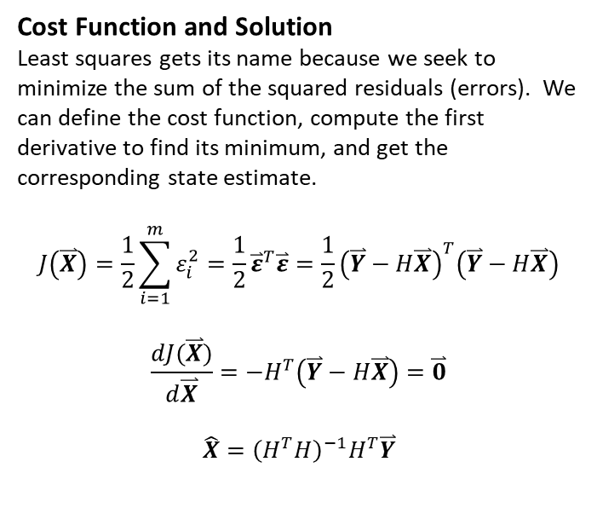
Least Squares Estimation
Cost Function and Solution
Least squares gets its name because we seek to minimize the sum of the squared residuals (errors). We can define the cost function, compute the first derivative to find its minimum, and get the corresponding state estimate.
$$J\left(\overset{⃑}{X}\right)=\frac{1}{2}\sum_{i=1}^{m}{ε_{i}^{2}}=\frac{1}{2}{\overset{⃑}{ε}}^{T}\overset{⃑}{ε}=\frac{1}{2}{\left(\overset{⃑}{Y}−H\overset{⃑}{X}\right)}^{T}\left(\overset{⃑}{Y}−H\overset{⃑}{X}\right)$$
$$\frac{dJ(\overset{⃑}{X})}{d\overset{⃑}{X}}=−H^{T}\left(\overset{⃑}{Y}−H\overset{⃑}{X}\right)=\overset{⃑}{0}$$
$$\hat{X}={\left(H^{T}H\right)}^{−1}H^{T}\overset{⃑}{Y}$$

Slide 33
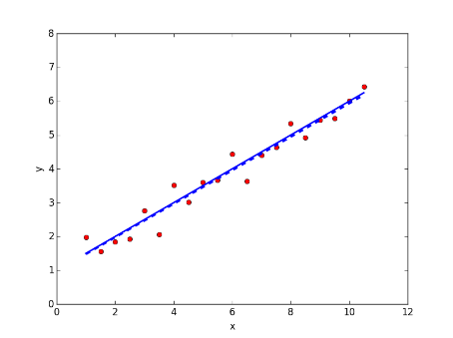
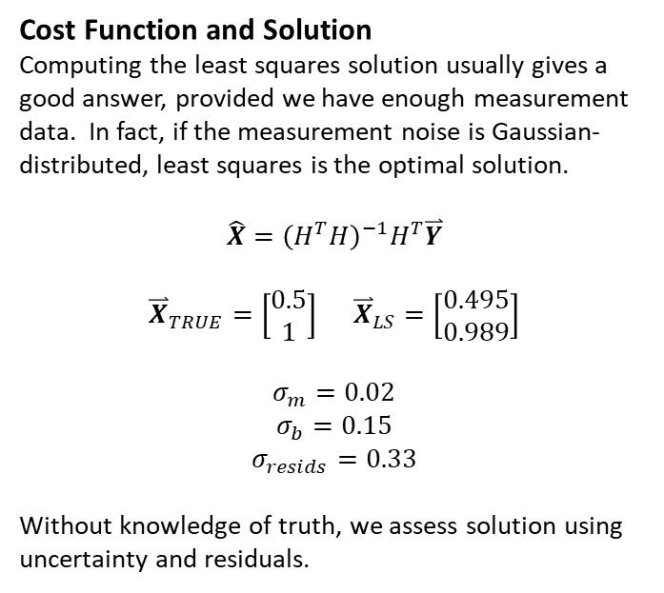
Least Squares Estimation
Cost Function and Solution
Computing the least squares solution usually gives a good answer, provided we have enough measurement data. In fact, if the measurement noise is Gaussian-distributed, least squares is the optimal solution.
$$\hat{X}={\left(H^{T}H\right)}^{−1}H^{T}\overset{⃑}{Y}$$
$${\overset{⃑}{X}}_{TRUE}=\left[\begin{matrix}0.5 \\ 1\end{matrix}\right] {\overset{⃑}{X}}_{LS}=\left[\begin{matrix}0.495 \\ 0.989\end{matrix}\right]$$
$$σ_{m}=0.02$$
$$σ_{b}=0.15$$
$$σ_{resids}=0.33$$
Without knowledge of truth, we assess solution using uncertainty and residuals.

Slide 34
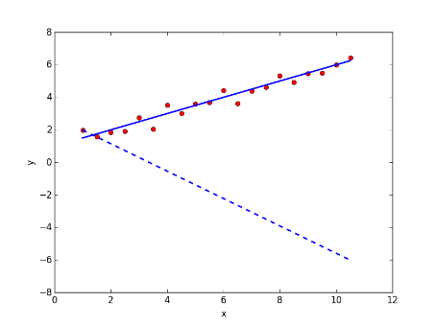
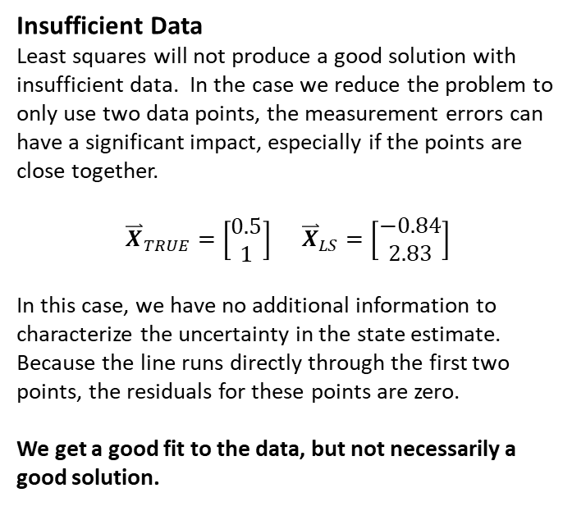
Least Squares Issues – Sparse Data
Insufficient Data
Least squares will not produce a good solution with insufficient data. In the case we reduce the problem to only use two data points, the measurement errors can have a significant impact, especially if the points are close together.
$${\overset{⃑}{X}}_{TRUE}=\left[\begin{matrix}0.5 \\ 1\end{matrix}\right] {\overset{⃑}{X}}_{LS}=\left[\begin{matrix}−0.84 \\ 2.83\end{matrix}\right]$$
In this case, we have no additional information to characterize the uncertainty in the state estimate. Because the line runs directly through the first two points, the residuals for these points are zero.
We get a good fit to the data, but not necessarily a good solution.

Slide 35
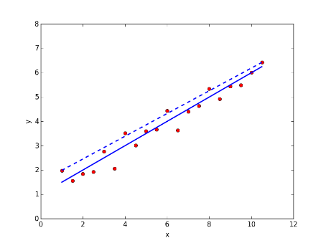
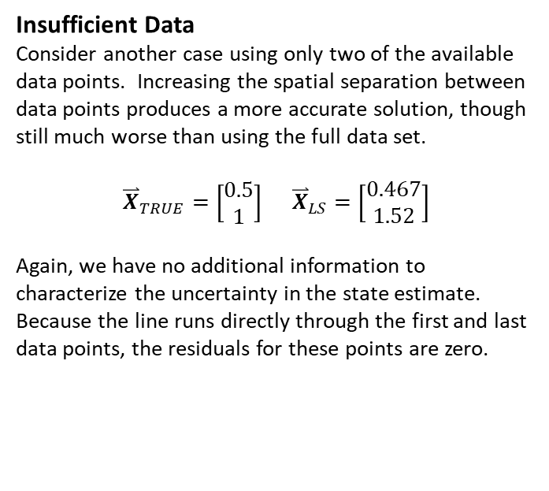
Least Squares Issues – Sparse Data
Insufficient Data
Consider another case using only two of the available data points. Increasing the spatial separation between data points produces a more accurate solution, though still much worse than using the full data set.
$${\overset{⃑}{X}}_{TRUE}=\left[\begin{matrix}0.5 \\ 1\end{matrix}\right] {\overset{⃑}{X}}_{LS}=\left[\begin{matrix}0.467 \\ 1.52\end{matrix}\right]$$
Again, we have no additional information to characterize the uncertainty in the state estimate. Because the line runs directly through the first and last data points, the residuals for these points are zero.

Slide 36
Linear Motion Example

Slide 37
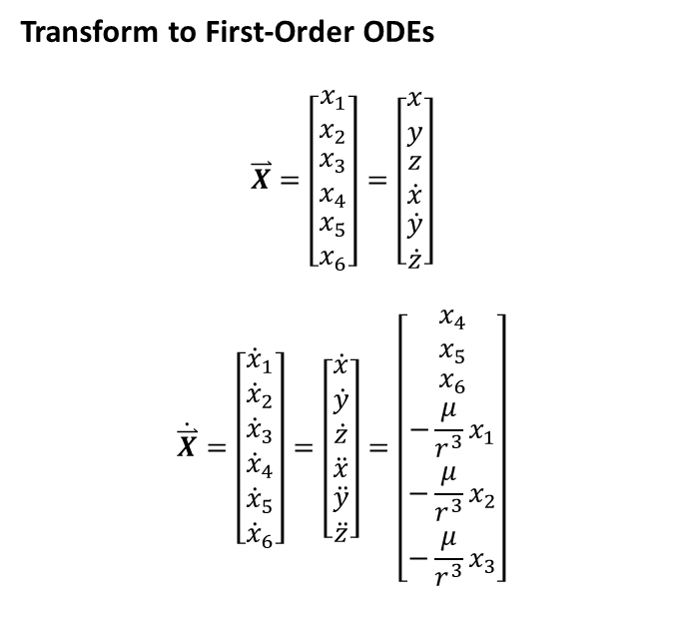


Linear Systems
Linear vs Nonlinear Dynamics
Orbital mechanics is a nonlinear dynamical system, meaning the time rate of change of the state vector (first derivative) is a nonlinear function of the states themselves. In particular, the two-body equations of motion form a set of coupled, 2nd order, nonlinear, ordinary differential equations (ODEs):
Transform to First-Order ODEs
$$\overset{⃑}{X}=\left[\begin{matrix}x_{1} \\ x_{2} \\ \begin{matrix}x_{3} \\ x_{4} \\ \begin{matrix}x_{5} \\ x_{6}\end{matrix}\end{matrix}\end{matrix}\right]=\left[\begin{matrix}x \\ y \\ \begin{matrix}z \\ \dot{x} \\ \begin{matrix}\dot{y} \\ \dot{z}\end{matrix}\end{matrix}\end{matrix}\right]$$
$$\dot{\overset{⃑}{X}}=\left[\begin{matrix}{\dot{x}}_{1} \\ {\dot{x}}_{2} \\ \begin{matrix}{\dot{x}}_{3} \\ {\dot{x}}_{4} \\ \begin{matrix}{\dot{x}}_{5} \\ {\dot{x}}_{6}\end{matrix}\end{matrix}\end{matrix}\right]=\left[\begin{matrix}\dot{x} \\ \dot{y} \\ \begin{matrix}\dot{z} \\ \ddot{x} \\ \begin{matrix}\ddot{y} \\ \ddot{z}\end{matrix}\end{matrix}\end{matrix}\right]=\left[\begin{matrix}x_{4} \\ x_{5} \\ \begin{matrix}x_{6} \\ {−\frac{μ}{r^{3}}x}_{1} \\ \begin{matrix}{−\frac{μ}{r^{3}}x}_{2} \\ {−\frac{μ}{r^{3}}x}_{3}\end{matrix}\end{matrix}\end{matrix}\right]$$
$$\ddot{\overset{⃑}{r}}+\frac{μ}{r^{3}}\overset{⃑}{r}=0$$
$$\ddot{x}=−\frac{μ}{r^{3}}x$$
$$\ddot{y}=−\frac{μ}{r^{3}}y$$
$$\ddot{z}=−\frac{μ}{r^{3}}z$$
$$r=\sqrt{x^{2}+y^{2}+z^{2}}$$

Slide 38
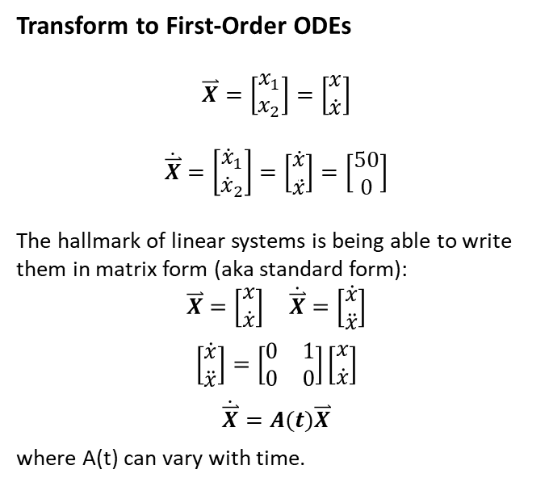
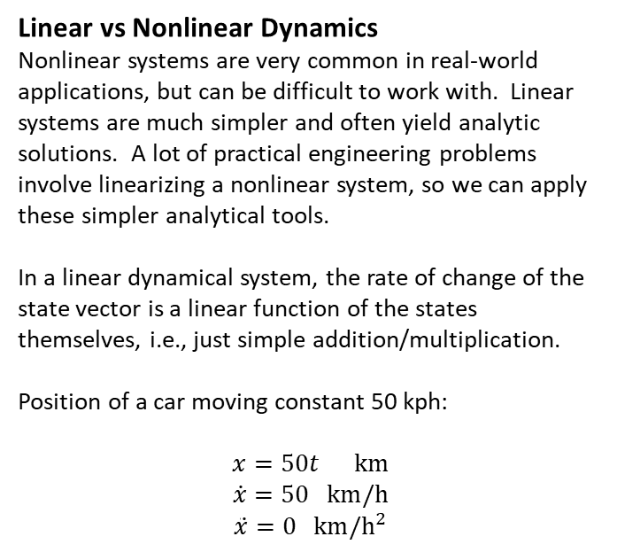
Linear Systems
Linear vs Nonlinear Dynamics
Nonlinear systems are very common in real-world applications, but can be difficult to work with. Linear systems are much simpler and often yield analytic solutions. A lot of practical engineering problems involve linearizing a nonlinear system, so we can apply these simpler analytical tools.
In a linear dynamical system, the rate of change of the state vector is a linear function of the states themselves, i.e., just simple addition/multiplication.
Position of a car moving constant 50 kph:
$$x=50t km$$
$$\dot{x}=50 km/h$$
$$\ddot{x}=0 km/h^{2}$$
Transform to First-Order ODEs
$$\overset{⃑}{X}=\left[\begin{matrix}x_{1} \\ x_{2}\end{matrix}\right]=\left[\begin{matrix}x \\ \dot{x}\end{matrix}\right]$$
$$\dot{\overset{⃑}{X}}=\left[\begin{matrix}{\dot{x}}_{1} \\ {\dot{x}}_{2}\end{matrix}\right]=\left[\begin{matrix}\dot{x} \\ \ddot{x}\end{matrix}\right]=\left[\begin{matrix}50 \\ 0\end{matrix}\right]$$
The hallmark of linear systems is being able to write them in matrix form (aka standard form):
$$\overset{⃑}{X}=\left[\begin{matrix}x \\ \dot{x}\end{matrix}\right] \dot{\overset{⃑}{X}}=\left[\begin{matrix}\dot{x} \\ \ddot{x}\end{matrix}\right]$$
$$\left[\begin{matrix}\dot{x} \\ \ddot{x}\end{matrix}\right]=\left[\begin{matrix}0 & 1 \\ 0 & 0\end{matrix}\right]\left[\begin{matrix}x \\ \dot{x}\end{matrix}\right]$$
$$\dot{\overset{⃑}{X}}=A(t)\overset{⃑}{X}$$
where A(t) can vary with time.

Slide 39
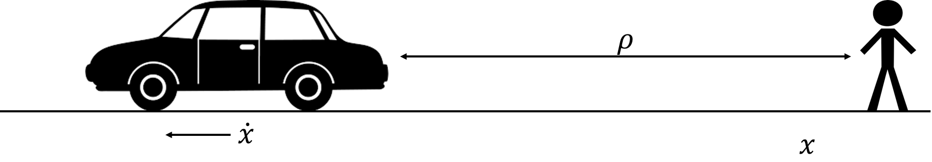
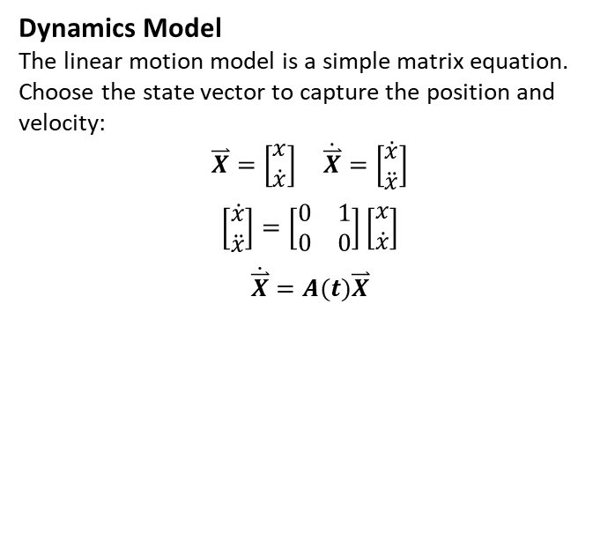

Linear Motion Model
Problem Statement
Consider a simple example involving linear motion. Your friend is driving his car down a straight road at constant velocity. You periodically take range measurements using a laser with Gaussian-distributed noise such that $σ_{ρ}=0.5 m$. How do you determine where the car is over time?
Dynamics Model
The linear motion model is a simple matrix equation. Choose the state vector to capture the position and velocity:
$$\overset{⃑}{X}=\left[\begin{matrix}x \\ \dot{x}\end{matrix}\right] \dot{\overset{⃑}{X}}=\left[\begin{matrix}\dot{x} \\ \ddot{x}\end{matrix}\right]$$
$$\left[\begin{matrix}\dot{x} \\ \ddot{x}\end{matrix}\right]=\left[\begin{matrix}0 & 1 \\ 0 & 0\end{matrix}\right]\left[\begin{matrix}x \\ \dot{x}\end{matrix}\right]$$
$$\dot{\overset{⃑}{X}}=A(t)\overset{⃑}{X}$$

Slide 40
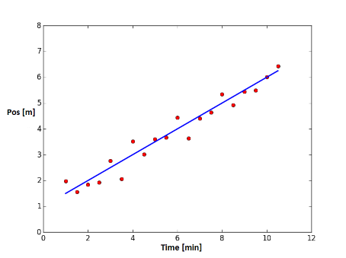
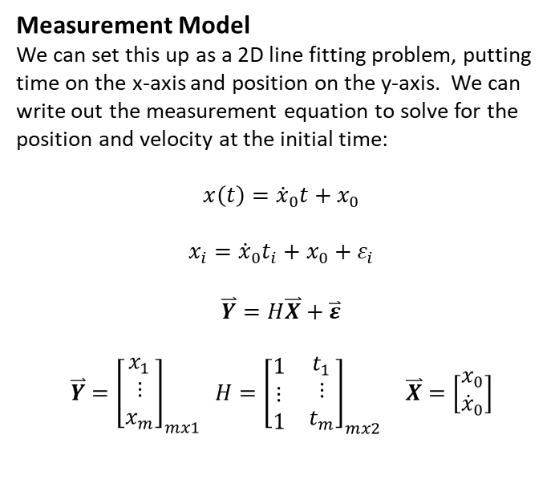
Linear Motion Model
Measurement Model
We can set this up as a 2D line fitting problem, putting time on the x-axis and position on the y-axis. We can write out the measurement equation to solve for the position and velocity at the initial time:
$$x\left(t\right)={\dot{x}}_{0}t+x_{0}$$
$$x_{i}={\dot{x}}_{0}t_{i}+x_{0}+ε_{i}$$
$$\overset{⃑}{Y}=H\overset{⃑}{X}+\overset{⃑}{ε}$$
$$\overset{⃑}{Y}={\left[\begin{matrix}x_{1} \\ ⋮ \\ x_{m}\end{matrix}\right]}_{mx1} H={\left[\begin{matrix}\begin{matrix}1 \\ ⋮ \\ 1\end{matrix} & \begin{matrix}t_{1} \\ ⋮ \\ t_{m}\end{matrix}\end{matrix}\right]}_{mx2} \overset{⃑}{X}=\left[\begin{matrix}x_{0} \\ {\dot{x}}_{0}\end{matrix}\right]$$

Slide 41
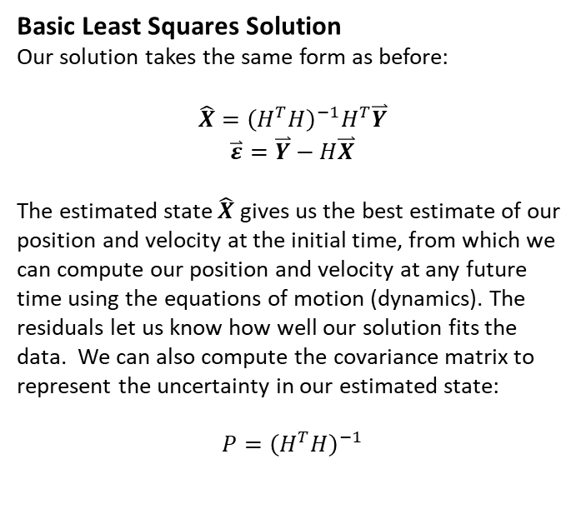
Linear Motion Model
Basic Least Squares Solution
Our solution takes the same form as before:
$$\hat{X}={\left(H^{T}H\right)}^{−1}H^{T}\overset{⃑}{Y}$$
$$\overset{⃑}{ε}=\overset{⃑}{Y}−H\overset{⃑}{X}$$
The estimated state $\hat{X}$ gives us the best estimate of our position and velocity at the initial time, from which we can compute our position and velocity at any future time using the equations of motion (dynamics). The residuals let us know how well our solution fits the data. We can also compute the covariance matrix to represent the uncertainty in our estimated state:
$${P=\left(H^{T}H\right)}^{−1}$$
Shortcomings
The standard least squares solution has some notable shortcomings that can be improved:
Each measurement error is weighted equally even though the accuracy of measurements may differ (we may have different sensors of different quality, or providing different types of measurements). Ideally we would weight better measurements higher to compute a more accurate solution.
Doesn’t account for the possibility of correlated measurement errors.
Makes no use of statistical information about measurement errors.

Slide 42
Minimum Variance Estimate

Slide 43
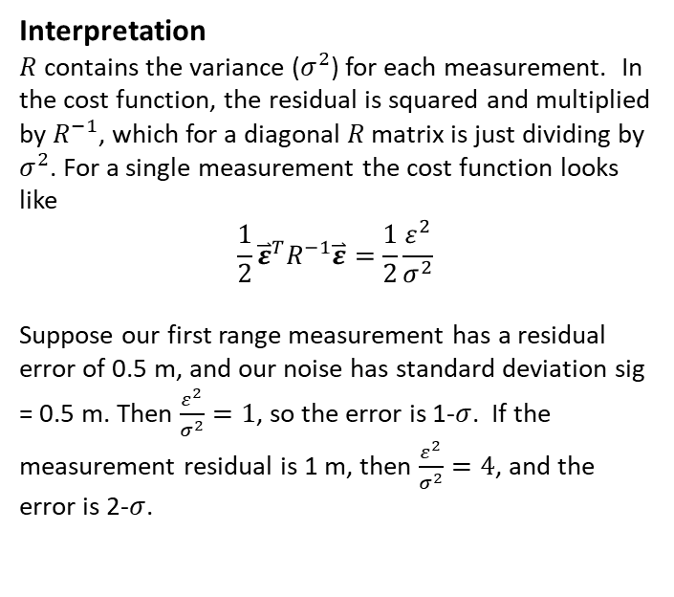
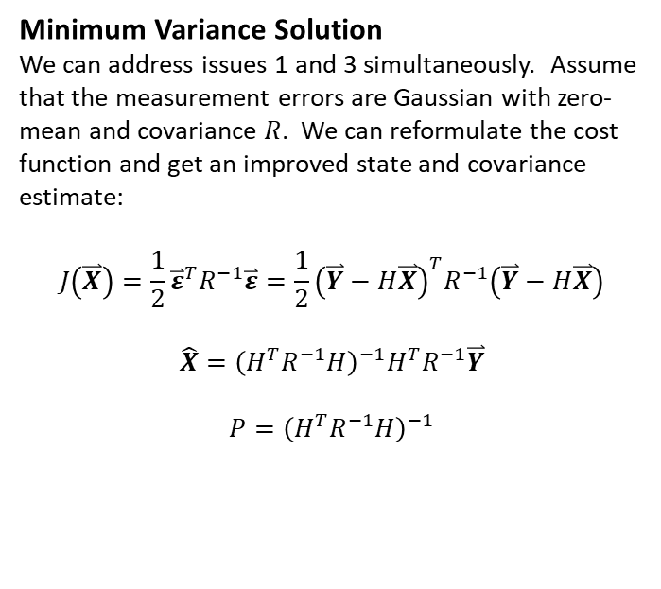
Minimum Variance Estimate
Minimum Variance Solution
We can address issues 1 and 3 simultaneously. Assume that the measurement errors are Gaussian with zero-mean and covariance $R$. We can reformulate the cost function and get an improved state and covariance estimate:
$$J\left(\overset{⃑}{X}\right)=\frac{1}{2}{\overset{⃑}{ε}}^{T}R^{−1}\overset{⃑}{ε}=\frac{1}{2}{\left(\overset{⃑}{Y}−H\overset{⃑}{X}\right)}^{T}R^{−1}\left(\overset{⃑}{Y}−H\overset{⃑}{X}\right)$$
$$\hat{X}={\left(H^{T}R^{−1}H\right)}^{−1}H^{T}R^{−1}\overset{⃑}{Y}$$
$${P=\left(H^{T}R^{−1}H\right)}^{−1}$$
Interpretation
$R$ contains the variance ($σ^{2}$) for each measurement. In the cost function, the residual is squared and multiplied by $R^{−1}$, which for a diagonal $R$ matrix is just dividing by $σ^{2}$. For a single measurement the cost function looks like
$$\frac{1}{2}{\overset{⃑}{ε}}^{T}R^{−1}\overset{⃑}{ε}=\frac{1}{2}\frac{ε^{2}}{σ^{2}}$$
Suppose our first range measurement has a residual error of 0.5 m, and our noise has standard deviation sig = 0.5 m. Then $\frac{ε^{2}}{σ^{2}}=1$, so the error is 1-$σ$. If the measurement residual is 1 m, then $\frac{ε^{2}}{σ^{2}}=4$, and the error is 2-$σ$.

Slide 44
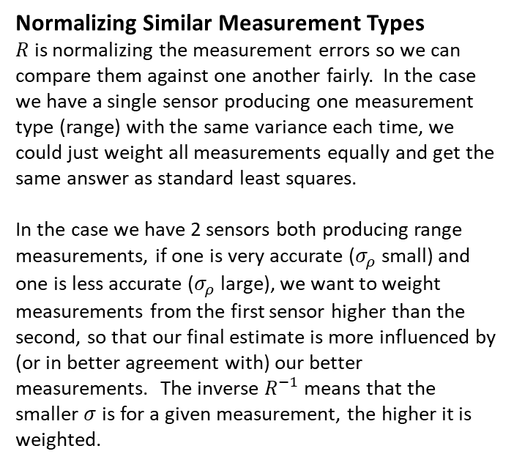
Minimum Variance Estimate
Normalizing Similar Measurement Types
$R$ is normalizing the measurement errors so we can compare them against one another fairly. In the case we have a single sensor producing one measurement type (range) with the same variance each time, we could just weight all measurements equally and get the same answer as standard least squares.
In the case we have 2 sensors both producing range measurements, if one is very accurate ($σ_{ρ}$ small) and one is less accurate ($σ_{ρ}$ large), we want to weight measurements from the first sensor higher than the second, so that our final estimate is more influenced by (or in better agreement with) our better measurements. The inverse $R^{−1}$ means that the smaller $σ$ is for a given measurement, the higher it is weighted.
Normalizing Different Measurement Types
Finally, in the case we have multiple measurement types like range/az/el, the units are all different (meters, radians, etc). It makes no sense to combine them evenly. Normalizing through R gives us a way to compare and weight the measurements based on their individual variances so it is an apples-to-apples comparison between different measurement types, and we weight based on how good the measurements are.
Bottom-line, minimum variance least squares estimation is simple to implement and should outperform basic least squares, and is therefore commonly used.

Slide 45
A Priori Information

Slide 46
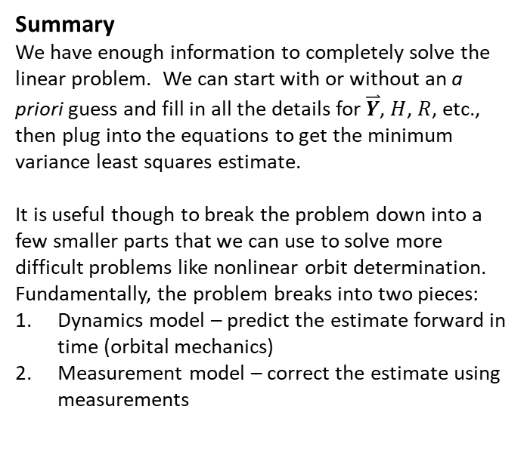

A Priori Information
Incorporating Prior Knowledge
To this point, we have assumed we start with no knowledge, so solutions are computed entirely based on the measurements. Often, though, we have some initial guess, which we call the a priori or “prior” solution. This information can be incorporated into our estimation process by treating it like a measurement. We denote the a priori state and covariance with a bar symbol to produce:
$$\hat{X}={\left(H^{T}R^{−1}H+{\overline{P}}_{0}^{−1}\right)}^{−1}\left(H^{T}R^{−1}\overset{⃑}{Y}+{\overline{P}}_{0}^{−1}{\overline{X}}_{0}\right)$$
$${P=\left(H^{T}R^{−1}H+{\overline{P}}_{0}^{−1}\right)}^{−1}$$
Summary
We have enough information to completely solve the linear problem. We can start with or without an a priori guess and fill in all the details for $\overset{⃑}{Y}$, $H$, $R$, etc., then plug into the equations to get the minimum variance least squares estimate.
It is useful though to break the problem down into a few smaller parts that we can use to solve more difficult problems like nonlinear orbit determination. Fundamentally, the problem breaks into two pieces:
Dynamics model – predict the estimate forward in time (orbital mechanics)
Measurement model – correct the estimate using measurements

Slide 47
Breaking Down the Problem

Slide 48


Dynamics Model
Linear Systems
Linear system dynamics are traditionally expressed as a set of 1st order ODEs in a matrix equation:
$$\dot{\overset{⃑}{X}}(t)=A(t)\overset{⃑}{X}(t)$$
State Transition Matrix
The solution to the ODE is given by a state transition matrix (STM)
$$\overset{⃑}{X}\left(t_{k}\right)=φ(t_{k},t_{0})\overset{⃑}{X}\left(t_{0}\right)$$
Given state at $t_{0}$, we can compute state at any future $t_{k}$.
Properties
STMs have some useful properties:
$φ\left(t_{k},t_{k}\right)=I$
$φ\left(t_{i},t_{k}\right)=φ\left(t_{i},t_{j}\right)$ $φ\left(t_{j},t_{k}\right)$
$φ\left(t_{i},t_{k}\right)=φ^{−1}(t_{k},t_{i})$
Computing the STM
The state transition matrix itself is computed from an ODE:
$$\dot{φ}(t,t_{k})=A(t)φ(t,t_{k})$$
Note that this is the same $A(t)$matrix as before, and we apply the initial condition from Property 1 for the integration.

Slide 49


Dynamics Model
Linear Motion Example
Returning to our previous example of linear motion, estimating the position and velocity of a car. The dynamics equation is
$$\dot{\overset{⃑}{X}}\left(t\right)=\left[\begin{matrix}0 & 1 \\ 0 & 0\end{matrix}\right]\overset{⃑}{X}\left(t\right) A\left(t\right)=\left[\begin{matrix}0 & 1 \\ 0 & 0\end{matrix}\right]$$
The ODE for the state transition matrix is therefore:
$$\dot{φ}(t,t_{k})=\left[\begin{matrix}0 & 1 \\ 0 & 0\end{matrix}\right]φ(t,t_{k})$$
with initial condition $φ\left(t_{k},t_{k}\right)=\left[\begin{matrix}1 & 0 \\ 0 & 1\end{matrix}\right]$.
$${\dot{φ}}_{11}=0, { φ}_{11}\left(0\right)=1{ φ}_{11}\left(t\right)=1$$
$${\dot{φ}}_{12}=1, { φ}_{12}\left(0\right)=0{ φ}_{12}\left(t\right)=t$$
$${\dot{φ}}_{21}=0, { φ}_{21}\left(0\right)=0{ φ}_{21}\left(t\right)=0$$
$${\dot{φ}}_{22}=0, { φ}_{22}\left(0\right)=1{ φ}_{22}\left(t\right)=1$$
State Transition Matrix
Therefore the STM for the linear motion example is
$$φ\left(t,t_{k}\right)=\left[\begin{matrix}1 & t \\ 0 & 1\end{matrix}\right]$$
This is a simple problem and yields a simple solution. More generally, the STM can be computed numerically using RK4, ode45, etc. This is done in code by augmenting the state vector with the STM components:
$$\overset{⃑}{X}\left(t\right)=\left[\begin{matrix}x \\ \dot{x} \\ \begin{matrix}φ_{11} \\ φ_{12} \\ \begin{matrix}φ_{21} \\ φ_{22}\end{matrix}\end{matrix}\end{matrix}\right] \dot{\overset{⃑}{X}}\left(t\right)=\left[\begin{matrix}\dot{x} \\ \ddot{x} \\ \begin{matrix}{\dot{φ}}_{11} \\ {\dot{φ}}_{12} \\ \begin{matrix}{\dot{φ}}_{21} \\ {\dot{φ}}_{22}\end{matrix}\end{matrix}\end{matrix}\right]$$
This set of 1st order ODEs is suitable for solving with numerical integration (can use reshape() function to go between column vector and matrices as needed).

Slide 50


Measurements Model
Linear Motion Example
Linear system measurements are also traditionally expressed as a matrix equation. At time $t_{k}$, the equation is
$${\overset{⃑}{Y}}_{k}={\tilde{H}}_{k}{\overset{⃑}{X}}_{k}+{\overset{⃑}{ε}}_{k}$$
where ${\tilde{H}}_{k}$ is the observation mapping matrix and provides the relationship between measurement space and state space.
We want to collect all of our measurements into one vector $\overset{⃑}{Y}$ all dependent on the state vector at the initial time ${\overset{⃑}{X}}_{0}$ which we can do using the STM.
Relating Measurements to Epoch State
Recall that the STM maps ${\overset{⃑}{X}}_{0}$ to any future time, we can therefore write all of the measurements as a function of epoch state.
$${\overset{⃑}{Y}}_{1}={\tilde{H}}_{1}φ\left(t_{1},t_{0}\right){\overset{⃑}{X}}_{0}+{\overset{⃑}{ε}}_{1}$$
$${\overset{⃑}{Y}}_{2}={\tilde{H}}_{2}φ\left(t_{2},t_{0}\right){\overset{⃑}{X}}_{0}+{\overset{⃑}{ε}}_{2}$$
$$⋮$$
$${\overset{⃑}{Y}}_{m}={\tilde{H}}_{m}φ\left(t_{m},t_{0}\right){\overset{⃑}{X}}_{0}+{\overset{⃑}{ε}}_{m}$$
$$\overset{⃑}{Y}=H{\overset{⃑}{X}}_{0}+\overset{⃑}{ε} H=\left[\begin{matrix}\begin{matrix}{\tilde{H}}_{1}φ\left(t_{1},t_{0}\right) \\ {\tilde{H}}_{2}φ\left(t_{2},t_{0}\right)\end{matrix} \\ ⋮ \\ {\tilde{H}}_{m}φ\left(t_{m},t_{0}\right)\end{matrix}\right]$$

Slide 51


Combined Model and Solution
Linear Motion Example
For the linear motion example, the range measurement at each time is just equal to the position with some noise added. This means the observation mapping matrix
$${\tilde{H}}_{k}=\left[\begin{matrix}1 & 0\end{matrix}\right]$$
At time $t_{k}$ the STM is given by
$$φ\left(t_{k},t_{0}\right)=\left[\begin{matrix}1 & t_{k} \\ 0 & 1\end{matrix}\right]$$
The product then gives the full $H$ matrix.
$${\tilde{H}}_{k}φ\left(t_{k},t_{0}\right)=\left[\begin{matrix}1 & 0\end{matrix}\right]\left[\begin{matrix}1 & t_{k} \\ 0 & 1\end{matrix}\right]=\left[\begin{matrix}1 & t_{k}\end{matrix}\right] H={\left[\begin{matrix}\begin{matrix}1 \\ ⋮ \\ 1\end{matrix} & \begin{matrix}t_{1} \\ ⋮ \\ t_{m}\end{matrix}\end{matrix}\right]}_{mx2}$$
Recall the problem as posed previously:
$$x\left(t\right)={\dot{x}}_{0}t+x_{0}$$
$$x_{i}={\dot{x}}_{0}t_{i}+x_{0}+ε_{i}$$
$$\overset{⃑}{Y}=H{\overset{⃑}{X}}_{0}+\overset{⃑}{ε}$$
$$\overset{⃑}{Y}={\left[\begin{matrix}x_{1} \\ ⋮ \\ x_{m}\end{matrix}\right]}_{mx1} H={\left[\begin{matrix}\begin{matrix}1 \\ ⋮ \\ 1\end{matrix} & \begin{matrix}t_{1} \\ ⋮ \\ t_{m}\end{matrix}\end{matrix}\right]}_{mx2} {\overset{⃑}{X}}_{0}=\left[\begin{matrix}x_{0} \\ {\dot{x}}_{0}\end{matrix}\right]$$
We have returned to our previous setup but with a more explicit process for computing the $H$ matrix in two steps:
Define the observation mapping ${\tilde{H}}_{k}$at each point in time
Use the STM to map each ${\tilde{H}}_{k}$ to the initial epoch time

Slide 52


Combined Model and Solution
Normal Equations
In fact, explicitly computing $H$ in this manner lends itself well to implementation in code. Recall the minimum variance least squares solution with a priori estimate:
$${\hat{X}}_{0}={\left(H^{T}R^{−1}H+{\overline{P}}_{0}^{−1}\right)}^{−1}\left(H^{T}R^{−1}\overset{⃑}{Y}+{\overline{P}}_{0}^{−1}{\overline{X}}_{0}\right)$$
$${P_{0}=\left(H^{T}R^{−1}H+{\overline{P}}_{0}^{−1}\right)}^{−1}$$
Define the Normal Equations:
$$Λ=H^{T}R^{−1}H+{\overline{P}}_{0}^{−1}$$
$$N=H^{T}R^{−1}\overset{⃑}{Y}+{\overline{P}}_{0}^{−1}{\overline{X}}_{0}$$
We can compute $Λ$ and $N$ using the given information and then solve:
$${\hat{X}}_{0}=Λ^{−1}N$$
$$P_{0}=Λ^{−1}$$
Accumulating the Normal Equations
Provided $R$ is block diagonal (measurements at different times are not correlated with one another), we can compute the normal equations with the following sums:
$$H^{T}R^{−1}H=\sum_{k=1}^{m}{{\left[{\tilde{H}}_{k}φ\left(t_{k},t_{0}\right)\right]}^{T}R_{k}^{−1}{\tilde{H}}_{k}φ\left(t_{k},t_{0}\right)}$$
$$H^{T}R^{−1}\overset{⃑}{Y}=\sum_{k=1}^{m}{{\left[{\tilde{H}}_{k}φ\left(t_{k},t_{0}\right)\right]}^{T}R_{k}^{−1}{\overset{⃑}{Y}}_{k}}$$
This lends itself perfectly to being implemented in a for loop in code. We step through the measurements one at a time, compute the STM and observation mapping matrix ${\tilde{H}}_{k}$, and add to the sums. At the end, compute ${\hat{X}}_{0}$ and $P_{0}$.

Slide 53
Batch Processing Algorithm

Slide 54

Batch Processing Algorithm
We are now ready to implement the batch processing algorithm, which processes a batch of measurements simultaneously to produce the best estimate of the state vector and its associated covariance (uncertainty) at the initial epoch.
For the linear problem, there is no need to iterate. One pass through the data will produce the minimum variance least squares estimate.
Step 1: Initialization
Set $Λ={\overline{P}}_{0}^{−1}$ and ${N=\overline{P}}_{0}^{−1}{\overline{X}}_{0}$ (assuming a priori available)
Step 2: Read the next observation
Retrieve $t_{k}$, ${\overset{⃑}{Y}}_{k}$, $R_{k}$
Integrate to get $φ\left(t_{k},t_{0}\right)$
Accumulate Normal Equations
Compute ${\tilde{H}}_{k}$
Compute $Λ=Λ+{\left[{\tilde{H}}_{k}φ\left(t_{k},t_{0}\right)\right]}^{T}R_{k}^{−1}{\tilde{H}}_{k}φ\left(t_{k},t_{0}\right)$
Compute $N=N+{\left[{\tilde{H}}_{k}φ\left(t_{k},t_{0}\right)\right]}^{T}R_{k}^{−1}{\overset{⃑}{Y}}_{k}$
Step 3: Repeat Step 2 until all measurements have been processed
Step 4: Solve the Normal Equations
$${\hat{X}}_{0}=Λ^{−1}N P_{0}=Λ^{−1}$$

Slide 55
Batch Least Squares Summary
Much of estimation is common sense, theory formalizes concepts and ideas that we have intuitively (weighted averaging, how much to trust measurements).
Least Squares is designed to fit a straight line through the middle of a series of noisy data.
Minimum Variance is about how much to trust each measurement.
Not all measurements are created equal
We want more accurate measurements to have more influence on the solution
Best fit line will be closer to accurate measurements and we don’t care as much if it’s not close to inaccurate measurements
Constant velocity example easily extends to 3D

Slide 56
Orbit Determination

Slide 57


Orbit Determination Problem
The key challenge posed by applying least squares estimation to orbit determination is that both the dynamics and measurement equations are nonlinear. Batch Least Squares is designed for linear systems, so we will have to make some adjustments.
Orbit Determination Example
Assume that we are tracking an object whose motion is governed by Two-Body dynamics, using range measurements from a ground-based sensor.
$$\overset{⃑}{X}=\left[\begin{matrix}\begin{matrix}x \\ y \\ z\end{matrix} \\ \dot{x} \\ \begin{matrix}\dot{y} \\ \dot{z}\end{matrix}\end{matrix}\right] \dot{\overset{⃑}{X}}=\left[\begin{matrix}\begin{matrix}\dot{x} \\ \dot{y} \\ \dot{z}\end{matrix} \\ −\frac{GM}{r^{3}}x \\ \begin{matrix}−\frac{GM}{r^{3}}y \\ −\frac{GM}{r^{3}}z\end{matrix}\end{matrix}\right]$$
$\overset{⃑}{Y}={\left[\begin{matrix}ρ_{1} \\ ⋮ \\ ρ_{m}\end{matrix}\right]}_{mx1}$

Slide 58



Dynamics Model
Nonlinear Systems
Nonlinear systems can often be linearized using techniques such as Taylor Series expansion. In this case, we find a reference trajectory, compute the first derivative of the dynamics with respect to the state, and drop the higher order terms.
Define a deviation vector $\overset{⃑}{x}={\overset{⃑}{X}}_{TRUE}−{\overset{⃑}{X}}_{REF}$. At the epoch time, we will estimate the deviation ${\hat{x}}_{0}$, which we can then use to get an estimate of the full state vector:
$${\hat{X}}_{0}={\overset{⃑}{X}}_{REF,0}+{\hat{x}}_{0}$$
Linearized System
The Taylor Series can be written out as
$${\dot{\overset{⃑}{X}}}_{TRUE}={\dot{\overset{⃑}{X}}}_{REF}+\left[\frac{∂\dot{\overset{⃑}{X}}}{∂\overset{⃑}{X}}\right]\overset{⃑}{x}+\frac{1}{2}\left[\frac{∂^{2}\dot{\overset{⃑}{X}}}{∂{\overset{⃑}{X}}^{2}}\right]{\overset{⃑}{x}}^{2}+…$$
Keeping only the linear terms yields
$${\dot{\overset{⃑}{X}}}_{TRUE}−{\dot{\overset{⃑}{X}}}_{REF}≈\left[\frac{∂\dot{\overset{⃑}{X}}}{∂\overset{⃑}{X}}\right]\overset{⃑}{x}$$
$$\dot{\overset{⃑}{x}}≈\left[\frac{∂\dot{\overset{⃑}{X}}}{∂\overset{⃑}{X}}\right]\overset{⃑}{x}$$
Note that this has the same form as our previous expression for linear dynamics
$$\dot{\overset{⃑}{x}}=A\left(t\right)\overset{⃑}{x} A\left(t\right)=\left[\frac{∂\dot{\overset{⃑}{X}}}{∂\overset{⃑}{X}}\right]$$

Slide 59

Measurement Model
We can apply the same concept to linearize the measurement equations.
Linearized Measurement Model
Assume that the nonlinear measurement equation is
$${\overset{⃑}{Y}}_{k}=G\left({\overset{⃑}{X}}_{k}\right)+{\overset{⃑}{ε}}_{k}$$
${\overset{⃑}{Y}}_{k}=G\left({\overset{⃑}{X}}_{REF,k}\right)+$ $\left[\frac{∂G}{∂\overset{⃑}{X}}\right]\overset{⃑}{x}+…$
$${\overset{⃑}{y}}_{k}={\overset{⃑}{Y}}_{k}−G\left({\overset{⃑}{X}}_{REF,k}\right)$$
$${\overset{⃑}{y}}_{k}≈{\tilde{H}}_{k}\overset{⃑}{x}+{\overset{⃑}{ε}}_{k}{ \tilde{H}}_{k}=\left[\frac{∂G}{∂\overset{⃑}{X}}\right]$$

Slide 60


Linearized Orbit Determination Model
Standard Form
By using Taylor Series expansion and keeping only first order terms, we have put the problem back in standard form:
$$\dot{\overset{⃑}{x}}=A\left(t\right)\overset{⃑}{x} {\overset{⃑}{y}}_{k}={\tilde{H}}_{k}\overset{⃑}{x}+{\overset{⃑}{ε}}_{k}$$
$$A\left(t\right)={\left[\frac{∂\dot{\overset{⃑}{X}}}{∂\overset{⃑}{X}}\right]}^{∗}{ \tilde{H}}_{k}={\left[\frac{∂G}{∂\overset{⃑}{X}}\right]}^{∗}$$
where the []* indicates the partial derivative is evaluated at the reference trajectory value ${\overset{⃑}{X}}_{REF}$.
We can compute the minimum variance least squares estimate just like before, with the note that the solution we obtain ${\hat{x}}_{0}$ is a deviation vector that must be added to ${\overset{⃑}{X}}_{REF,0}$ to get the full estimated state ${\hat{X}}_{0}$. The batch algorithm itself must be iterated to converge on a solution (usually fewer than 5 iterations).

Slide 61

Batch Processing Algorithm (Nonlinear OD)
Finally we have the nonlinear batch processing algorithm, suitable for use in orbit determination. The method processes a batch of measurements simultaneously to produce the best estimate of the state deviation vector and its associated covariance (uncertainty) at the initial epoch. The state deviation vector can be added to the reference trajectory to get the full estimated state at the initial epoch.
The nonlinear batch algorithm must be iterated to converge on the state deviation (when this value goes to zero it means our reference trajectory is now basically our solution). The initial guess at the reference trajectory must be somewhat close to the truth in order for the method to converge.
Step 0: Initialization
Set ${\hat{x}}_{0}={\overline{x}}_{0}=0$
Step 1: Initialize this iteration
Set $Λ={\overline{P}}_{0}^{−1}$ and ${N=\overline{P}}_{0}^{−1}{\overline{x}}_{0}$ (assuming a priori available)
Step 2: Read the next observation
Retrieve $t_{k}$, ${\overset{⃑}{Y}}_{k}$, $R_{k}$
Integrate to get $φ\left(t_{k},t_{0}\right)$ and ${\overset{⃑}{X}}_{REF,k}$
Accumulate Normal Equations
Compute ${\tilde{H}}_{k}$ using ${\overset{⃑}{X}}_{REF,k}$
Compute ${\overset{⃑}{y}}_{k}={\overset{⃑}{Y}}_{k}−G\left({\overset{⃑}{X}}_{REF,k}\right)$
Compute $Λ=Λ+{\left[{\tilde{H}}_{k}φ\left(t_{k},t_{0}\right)\right]}^{T}R_{k}^{−1}{\tilde{H}}_{k}φ\left(t_{k},t_{0}\right)$
Compute $N=N+{\left[{\tilde{H}}_{k}φ\left(t_{k},t_{0}\right)\right]}^{T}R_{k}^{−1}{\overset{⃑}{y}}_{k}$
Step 3: Repeat Step 2 until all measurements have been processed
Step 4: Solve the Normal Equations
$${\hat{x}}_{0}=Λ^{−1}N P_{0}=Λ^{−1}$$
Step 5: Check convergence ($\left\|{\hat{x}}_{0}\right\|<threshold$)
If not met, update and return to Step 1 (use original ${\overline{P}}_{0}^{−1}$):
$${\overset{⃑}{X}}_{REF,0}={\overset{⃑}{X}}_{REF,0}+{\hat{x}}_{0}$$
$${\overline{x}}_{0}={\overline{x}}_{0}−{\hat{x}}_{0}$$

Slide 62


Batch OD Example
Test Case Description
Circular LEO orbit
4 hour simulation
Measurements collected every minute from one ground-based sensor
Compare 3D range + angles vs 2D angles-only
No visibility constraints, see-through Earth
Noisy measurements generated from true trajectory with standard deviations $σ_{ρ}=1 m$ and $σ_{α/δ}=1 arcsec$
Solve for initial state, propagate estimate through full time window and compute errors
Plot 3-sigma error bounds from covariance matrix (also propagated from initial epoch)

Slide 63

Batch OD Results – 3D Measurements

Slide 64


Batch OD Results – 3D Measurements

Slide 65


Batch OD Results – 2D Measurements

Slide 66


Batch OD Results – 2D Measurements

Slide 67
Orbit Determination Batch Summary
We can solve nonlinear orbit determination problem using linear Batch Least Squares by applying Taylor Series to linearize the problem and put it in standard form
We use a measurement deviation vector (residuals) to update the state deviation vector, which we add to a reference trajectory to get the full estimated state vector
Have to iterate solution to converge
Only works if reference trajectory is close enough to truth that linear approximation is valid (radius of convergence), otherwise solutions will diverge
Not great for long data gaps, or long arcs in general (several days) in this case may be best to break data up in shorter segments and patch solutions together or process data in sliding window
Does not address Non-Gaussian uncertainty which is an issue for nonlinear problems in general and OD in particular

Slide 68
Partial Derivatives

Slide 69


Computing Partial Derivatives
Given a function of multiple variables, we wish to compute the derivative with respect to one variable:
$$f\left(x,y,z\right)=x^{2}\left(y^{3}−\frac{1}{z^{2}}\right)$$
$$\frac{∂f(x,y,z)}{∂x}=?$$
We do this by treating the other variables as constant and computing a partial derivative, observing product rule, chain rule, etc as with ordinary derivatives.
$$\frac{∂f(x,y,z)}{∂x}=2x\left(y^{3}−\frac{1}{z^{2}}\right)$$
$$\frac{∂f(x,y,z)}{∂y}=x^{2}\left({3y}^{2}−0\right)$$
$$\frac{∂f(x,y,z)}{∂z}=x^{2}\left(0+2\frac{1}{z^{3}}\right)$$
Taking partial derivatives of vectors produces a matrix.
$$\overset{⃑}{A}=\left[\begin{matrix}A_{1} \\ A_{2}\end{matrix}\right] \overset{⃑}{B}=\left[\begin{matrix}B_{1} \\ B_{2} \\ B_{3}\end{matrix}\right]$$
$$\left[\frac{∂\overset{⃑}{A}}{∂\overset{⃑}{B}}\right]=\left[\begin{matrix}\begin{matrix}\frac{∂A_{1}}{∂B_{1}} & \frac{∂A_{1}}{∂B_{2}} & \frac{∂A_{1}}{∂B_{3}}\end{matrix} \\ \begin{matrix}\frac{∂A_{2}}{∂B_{1}} & \frac{∂A_{2}}{∂B_{2}} & \frac{∂A_{2}}{∂B_{3}}\end{matrix}\end{matrix}\right]$$
Notice the way the terms fill in, the first vector changes across rows and the second vector changes across columns, therefore
number of rows = dimension of $\overset{⃑}{A}$
number of columns = dimension of $\overset{⃑}{B}$

Slide 70


Computing Partial Derivatives
Returning to the orbit determination problem, we need to compute the partial matrix:
$$A\left(t\right)=\left[\frac{∂\dot{\overset{⃑}{X}}}{∂\overset{⃑}{X}}\right]$$
where for the Two-Body Problem
$$\overset{⃑}{X}=\left[\begin{matrix}\begin{matrix}x \\ y \\ z\end{matrix} \\ \dot{x} \\ \begin{matrix}\dot{y} \\ \dot{z}\end{matrix}\end{matrix}\right] \dot{\overset{⃑}{X}}=\left[\begin{matrix}\begin{matrix}\dot{x} \\ \dot{y} \\ \dot{z}\end{matrix} \\ −\frac{GM}{r^{3}}x \\ \begin{matrix}−\frac{GM}{r^{3}}y \\ −\frac{GM}{r^{3}}z\end{matrix}\end{matrix}\right]$$
$$r={\left[x^{2}+y^{2}+z^{2}\right]}^{1/2}$$
Taking partial derivatives of individual terms across the first row, we realize that most terms end up being zero:
$$\frac{∂\dot{x}}{∂x}=0 \frac{∂\dot{x}}{∂y}=0 \frac{∂\dot{x}}{∂z}=0$$
$$\frac{∂\dot{x}}{∂\dot{x}}=1 \frac{∂\dot{x}}{∂\dot{y}}=0 \frac{∂\dot{x}}{∂\dot{y}}=0$$
This pattern repeats for the first three rows until we get to the Two-Body acceleration terms. Applying product/chain rules:
$$\frac{∂\ddot{x}}{∂x}=−\frac{GM}{r^{3}}−GMx\left(−\frac{3}{2}{\left[x^{2}+y^{2}+z^{2}\right]}^{−5/2}∙2x\right)$$
$$\frac{∂\ddot{x}}{∂x}=−\frac{GM}{r^{3}}+\frac{3GMx^{2}}{r^{5}}$$

Slide 71

Computing Partial Derivatives
For the Two-Body Problem, the full A matrix is given by:
$$A\left(t\right)=\left[\frac{∂\dot{\overset{⃑}{X}}}{∂\overset{⃑}{X}}\right]=\left[\begin{matrix}0 & 0 & 0 & 1 & 0 & 0 \\ 0 & 0 & 0 & 0 & 1 & 0 \\ 0 & 0 & 0 & 0 & 0 & 1 \\ −\frac{GM}{r^{3}}+\frac{3GMx^{2}}{r^{5}} & \frac{3GMxy}{r^{5}} & \frac{3GMxz}{r^{5}} & 0 & 0 & 0 \\ \frac{3GMxy}{r^{5}} & −\frac{GM}{r^{3}}+\frac{3GMy^{2}}{r^{5}} & \frac{3GMyz}{r^{5}} & 0 & 0 & 0 \\ \frac{3GMxz}{r^{5}} & \frac{3GMyz}{r^{5}} & −\frac{GM}{r^{3}}+\frac{3GMz^{2}}{r^{5}} & 0 & 0 & 0\end{matrix}\right]$$

